Slide 1
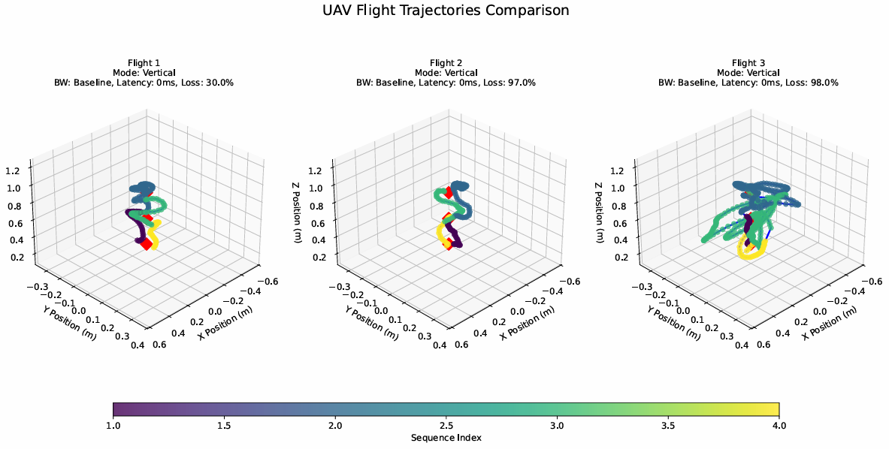

UAV Flight Performance Analysis Platform
Disen Jia 223314816
Who am I? As an Honours Student specializing in MEC-enabled autonomous UAV delivery systems, I want to create a platform to evaluate practical UAV performance.
My Vision: I will create a UAV Performance Analysis Platform that transforms real-world experimental data from my Honours research into interactive 3D visualizations, enabling analysis of UAV flight performance.
Impact: This website provides all drone flight enthusiasts and researchers with tools for generating historical flight trajectories of drones and verifying their flight performance.

